Slide 1
Tabbed Screen
Notes:
© 2006 Capgemini - All rights reserved
0

Slide 2
Why Tabbed Screen?
Group of version & enquiry needs to be displayed on same screen

Slide 3
Use of Tabbed Screen
Enables the browser to display a group of versions and enquiries on the same screen
Each enquiry / version is displayed on an individual “tab”
Each tab is completely independent and only one may be active at any given time but can share information
Switching tabs will lose all input to the previous tab

Slide 4
Tabbed Screen
Creation
Enter “EB.TABBED.SCREEN, I <id>”
Enter the required details & commit the record
Execution
Enter “TAB <id>” in command line
Click on required tab to view the output

Slide 5
Tabbed Screen
Types of Applications that can be a part of a tabbed screen
ENQ – Enquiry
TXN – Version
COS – Composite Screen
MENU – Core Menu/User Defined Menu
TAB – Another Tabbed Screen
URL – Link
UTILITY - Toolbox

Slide 6
Tabbed Screen
Information can be shared between tabs
Between Enquiry – Enquiry
Selection fields
Between Enquiry – Version
Selection field must be valid ID for version

Slide 7
Tabbed Screen
Each tab can be launched individually from the Command line
To launch Enquiry - TAB <ID> <TAB.NO> <Selection Criteria>
E.g. TAB SAMPLE2 TRG.ENQ ACCOUNT EQ 100101
To launch Version - TAB <ID> <ID TO LAUNCH VERSION>
E.g. TAB SAMPLE3 ACCOUNT,DETAILS

Slide 8
Example
Create a tabbed screen containing
Enquiry to list Account details
Version to create new customer record
Version to open an existing customer ‘100060’ in Input mode

Slide 9
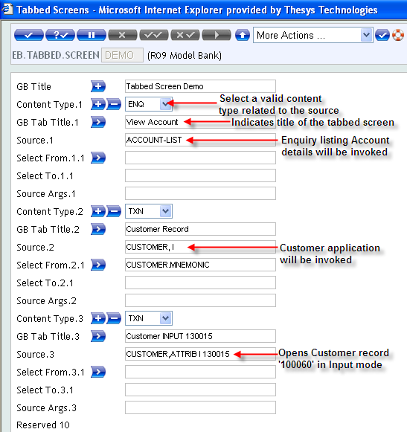
Solution
Create a tabbed screen as shown

Slide 10
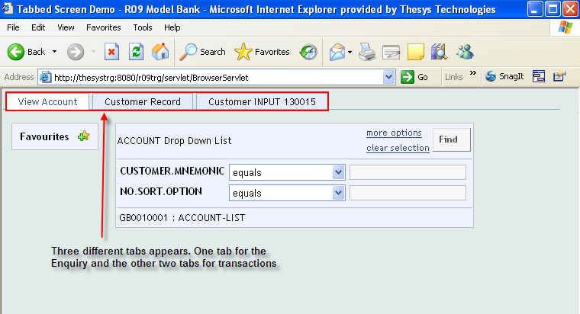
Solution
Output of the tabbed screen appears as shown

Slide 11
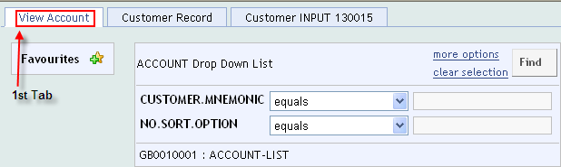
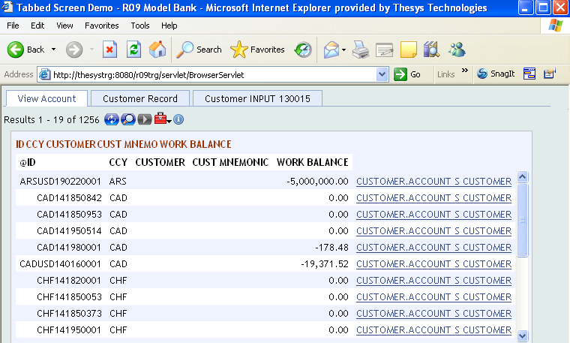
Solution
Click on the 1st Tab, to view the Account details

Slide 12
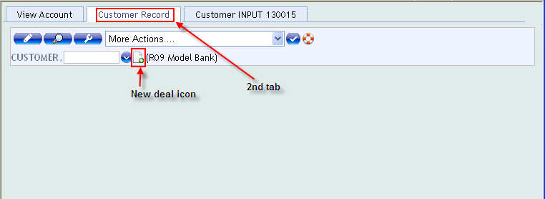
Solution
Click on the 2nd Tab
Click on new deal icon, to create a new Customer

Slide 13
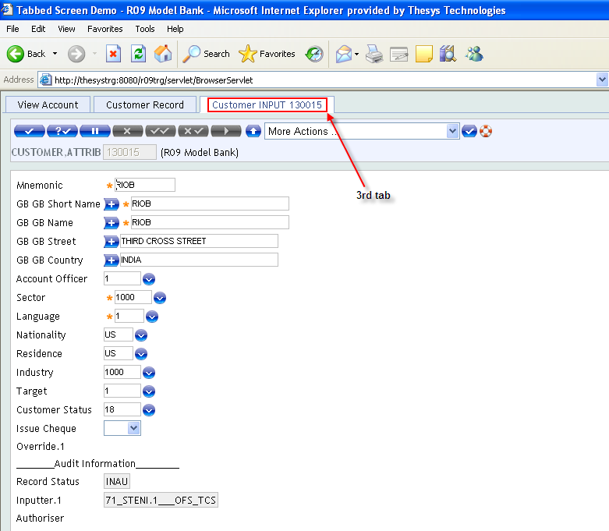
Solution
Click on the 3rd Tab, to open the existing customer ‘100060’ in Input mode

Slide 14
Composite Screen

Slide 15
Why Composite Screen?
Multiple but combined screens needs to be displayed
Browser window divided into frames

Slide 16
Composite Screen
Each frame contains a valid type of application
ENQ: This item is an Enquiry
TXN: This item is a contract screen (E.g. Version)
UTILITY: This allows you to call a browser routine. Not sure on the entire scope of this
TAB: This item is a tabbed screen
COS: This item is a composite screen

Slide 17
Composite Screen
MENU: This item is a menu
URL: This item is a URL
BLANK: This part of the frame remains blank

Slide 18
EB.COMPOSITE.SCREEN - Fields
CONTENT.TYPE
Mentioned in previous slide
COLS
Number of columns occupied by frame
ROWS
Number of rows occupied by frame
NAME

Slide 19
EB.COMPOSITE.SCREEN - Fields
SCROLLING
TARGET
CONTENT
Actual content of frame
ITEMS
ALL, NOENQ, ENQ,

Slide 20
Example
Create a composite screen containing
Enquiry listing Account details in one frame
Application to create Customer in the other frame

Slide 21
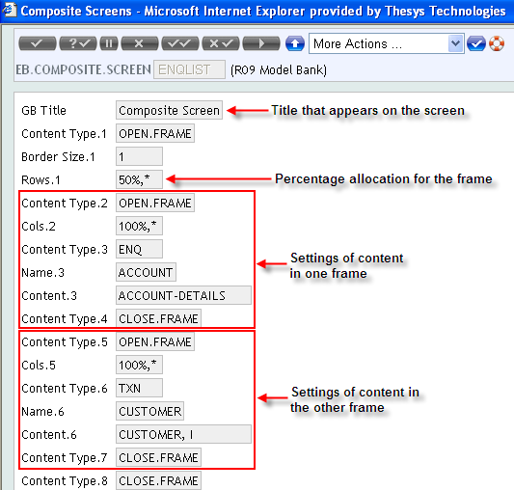
Solution
Create a composite screen as shown

Slide 22
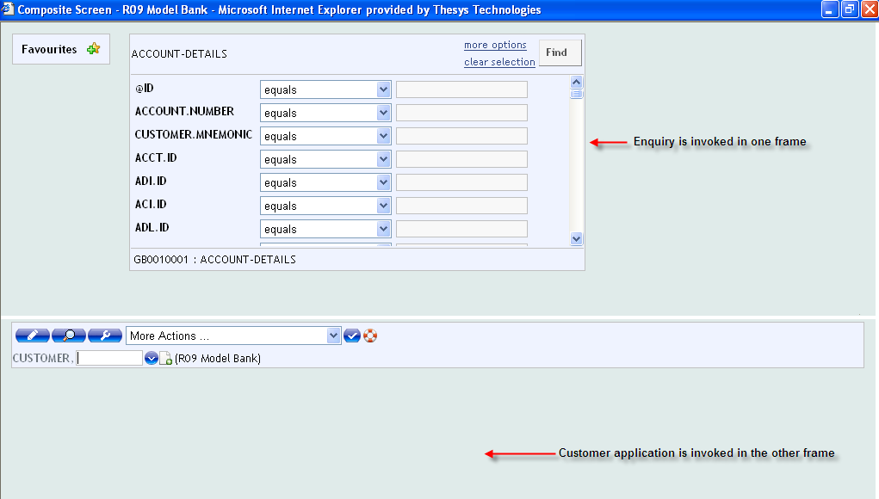
Solution
Output of the composite screen appears as shown

Slide 23
Example
Create a composite screen displaying vertically
Account details enquiry in one frame
Blank screen in the other frame

Slide 24
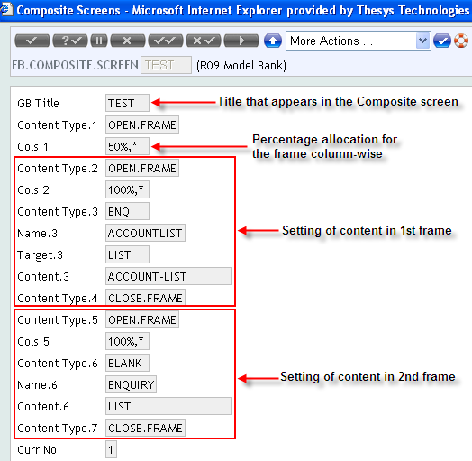
Solution
Create a composite screen as shown

Slide 25
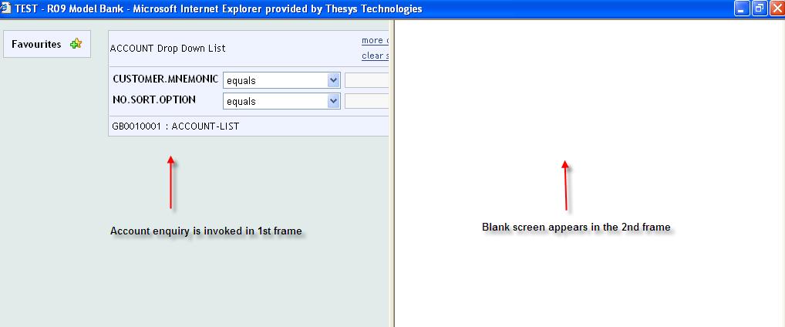
Solution
Output of the enquiry appears as shown

Slide 26
Example
Create a composite screen
To display the output of Customer details enquiry in one frame
To display output of child enquiry based on selection from the Customer details enquiry, in the same frame

Slide 27
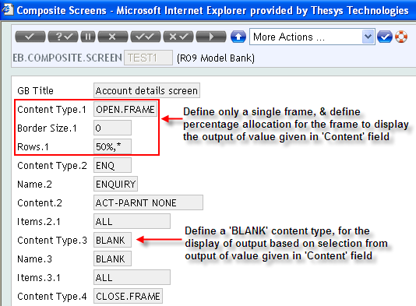
Solution
Create a composite screen as shown

Slide 28
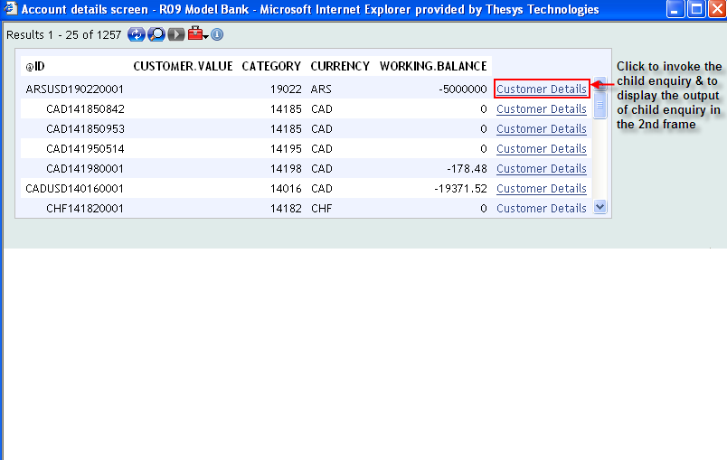
Solution
Output of the composite screen appears as shown

Slide 29
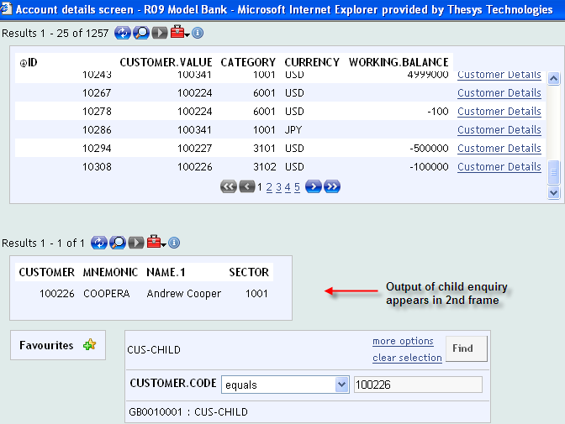
Solution

Slide 30
Summary
We have learnt
How to set field attributes
No Change Field, Mandatory Field & Re-key Field & No Input Field
How to create link between version
Next Version & Associated Version
About the authorization features available in version
Zero Authorization
Single Authorization
Double Authorization

Slide 31
Summary
How to control authorization rights for a particular version
Straight Through Processing (STP)
How to display group of applications in the same screen
Tabbed screen
How to divide browser window into frames containing different/same/linked applications
Composite screen

Slide 32


www.capgemini.com/financialservices

